Slide 1
Image-Based Situation Awareness Audit 8.5.2018
Sakari Lampola

Slide 2
Previous Audit 28.2.2018

Slide 3
Next steps
Kalman filter parameter adjustments (Q1)
Dataset selection (Q1)
Stereo vision (Q2)
Camera yaw, pitch, roll estimation (Q2)
Speech recognition (Q2)
Semantic segmentation (Q2)
Experiments in the wild (Q2)
Paper (Q3)
Speech analysis (Q3)
Speech generation (Q3)
Use cases (Q4)
Other
Body forecast
kinetic
based on class history
based on swarm history
R matrix estimation
Monograph or papers?

Slide 4
Project Plan

Slide 5

Methodology / Preparation of research infra
Software platforms are constructed and tested
Off-the-shelf models are acquired and tested
Necessary skills on platforms are learned
Methodology / Method survey
Current state-of-art methods are studied
Methods are constructed and tested on the software platforms
Method follow-up
Screening of conference papers related to the subject
Possibly integrating new methods to the project

Slide 6
Work Done

Slide 7
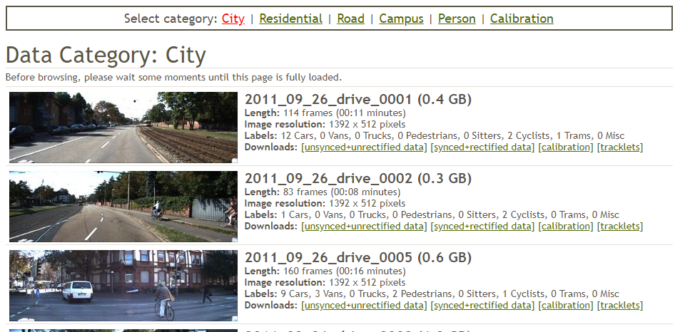
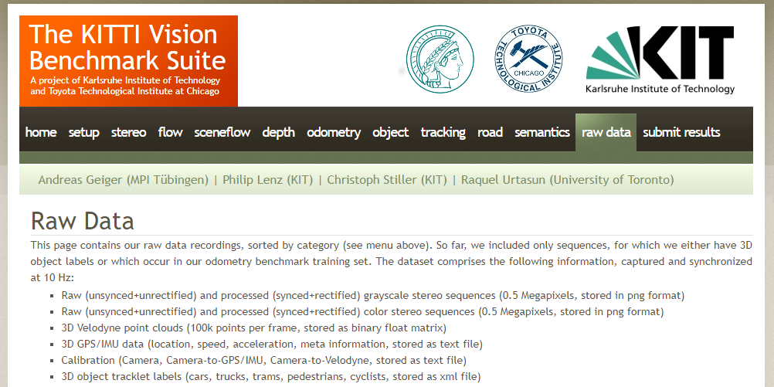
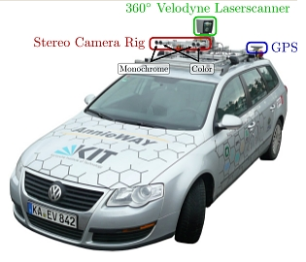
Specification:
Video
Stereo
Distance information
Outdoor + indoor
Odometry
Dataset Selection
Open question: Indoor? Self generated?

Slide 8
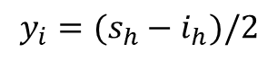
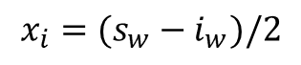
Image format / cropping
s_{w} = sensor pixel width = 1392
x_{i},y_{i}
i_{w} = image pixel width
s_{h} = sensor pixel height = 512
i_{h} = image pixel height
Assumptions:
image is symmetrically cropped (optical center fixed)
rectification ignored
$$x_{i}=(s_{w}−i_{w})/2$$
$$y_{i}=(s_{h}−i_{h})/2$$

Slide 9
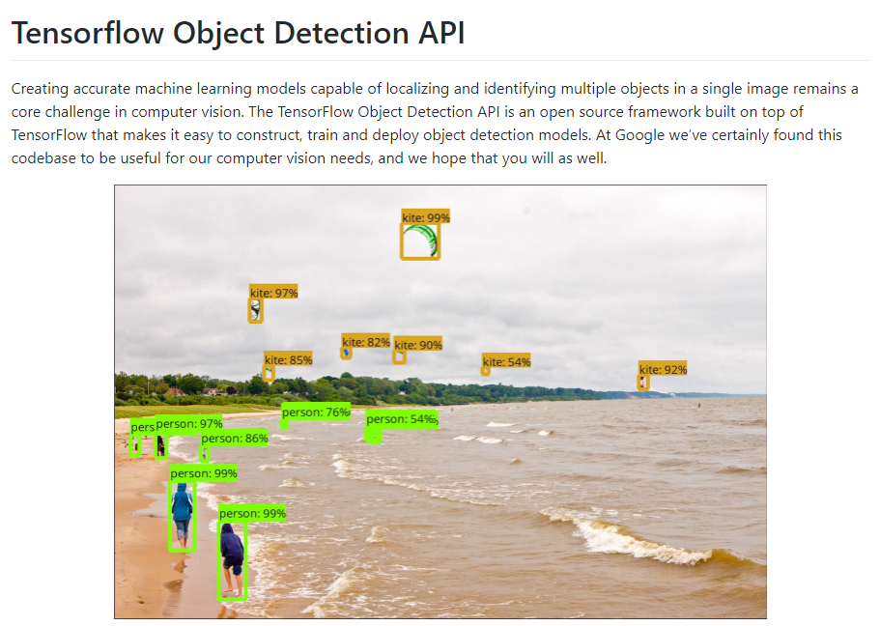
https://github.com/tensorflow/models/tree/master/research/object_detection

Slide 10
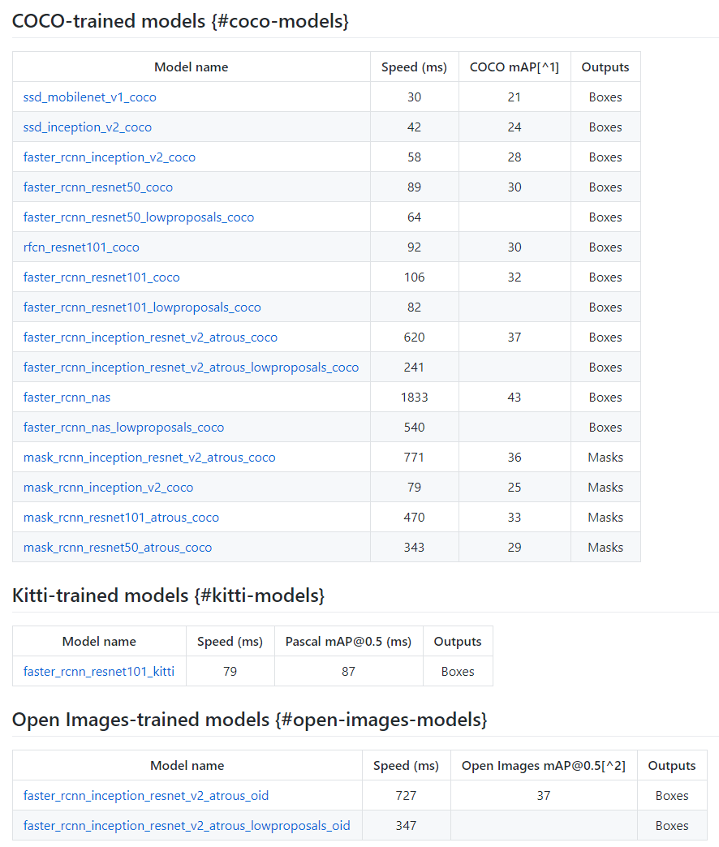
One of these will be the final model.
Lottery prize!!!! Will be used to implement localization and velocity estimation

Slide 11

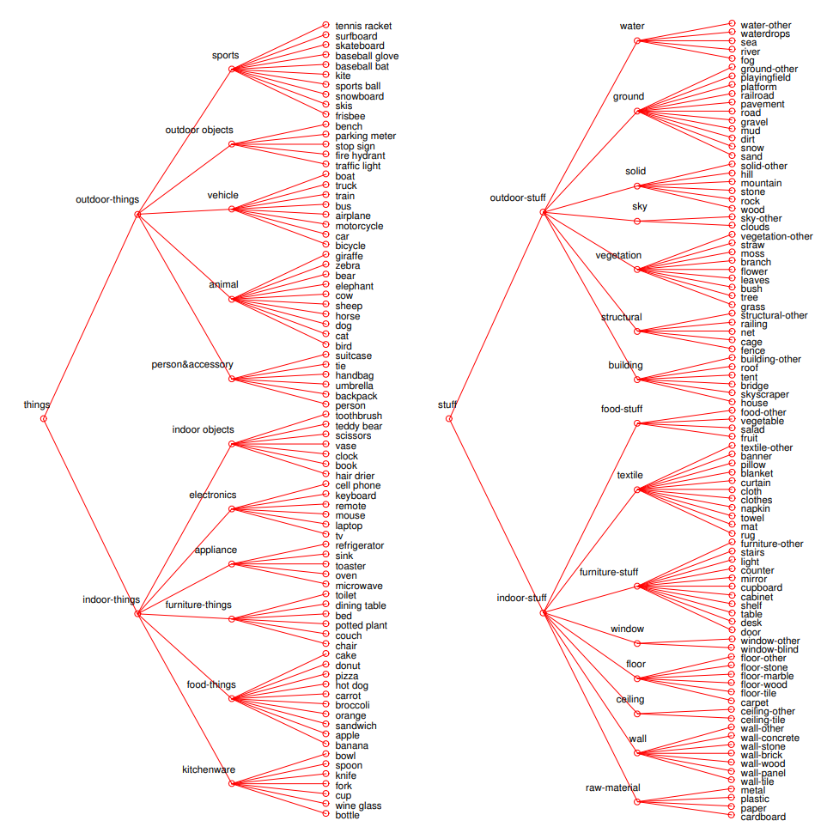

Slide 12
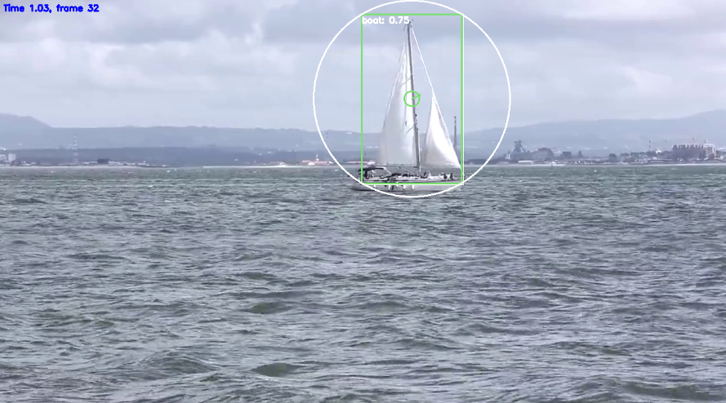
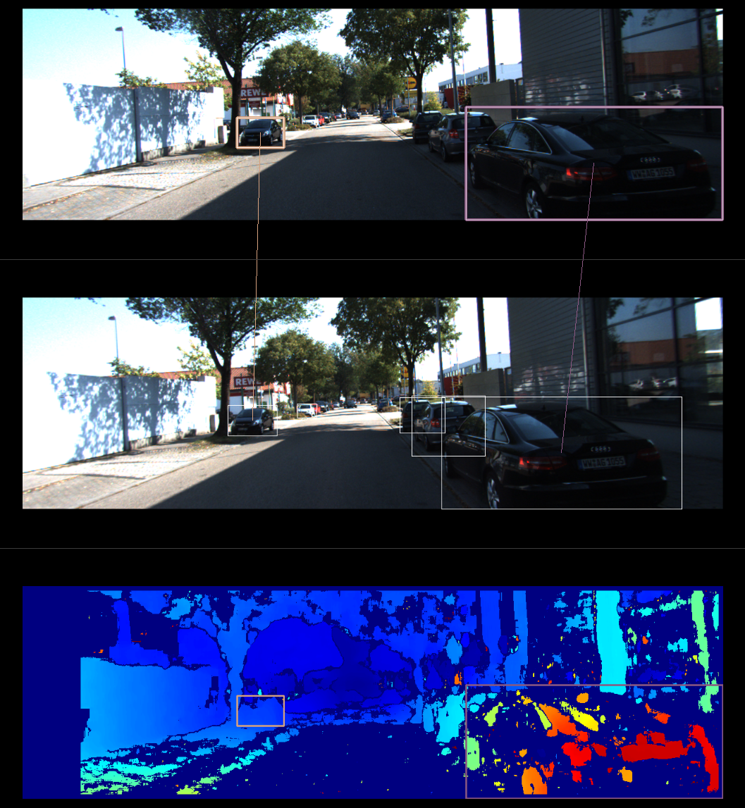
Left
Right
Stereo Vision
disparity d

Slide 13
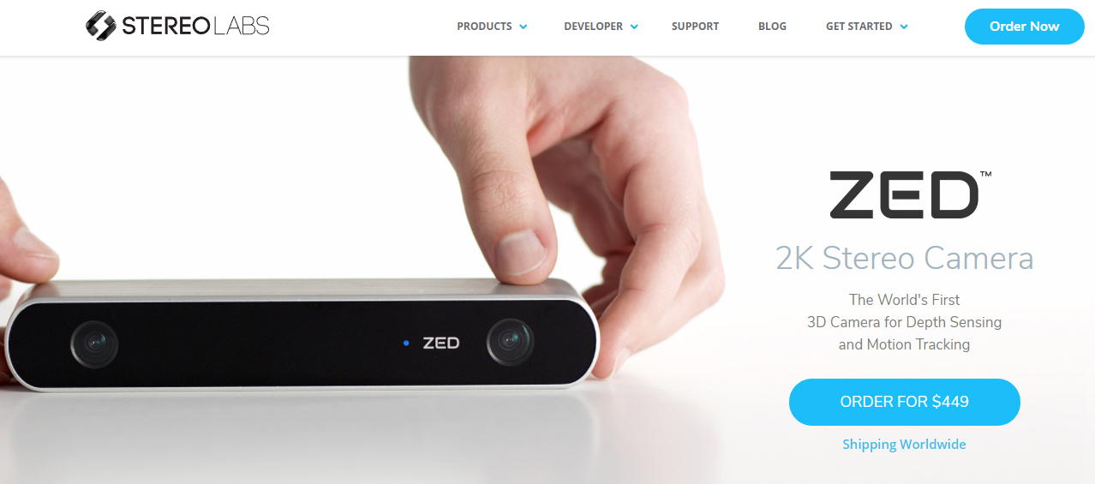
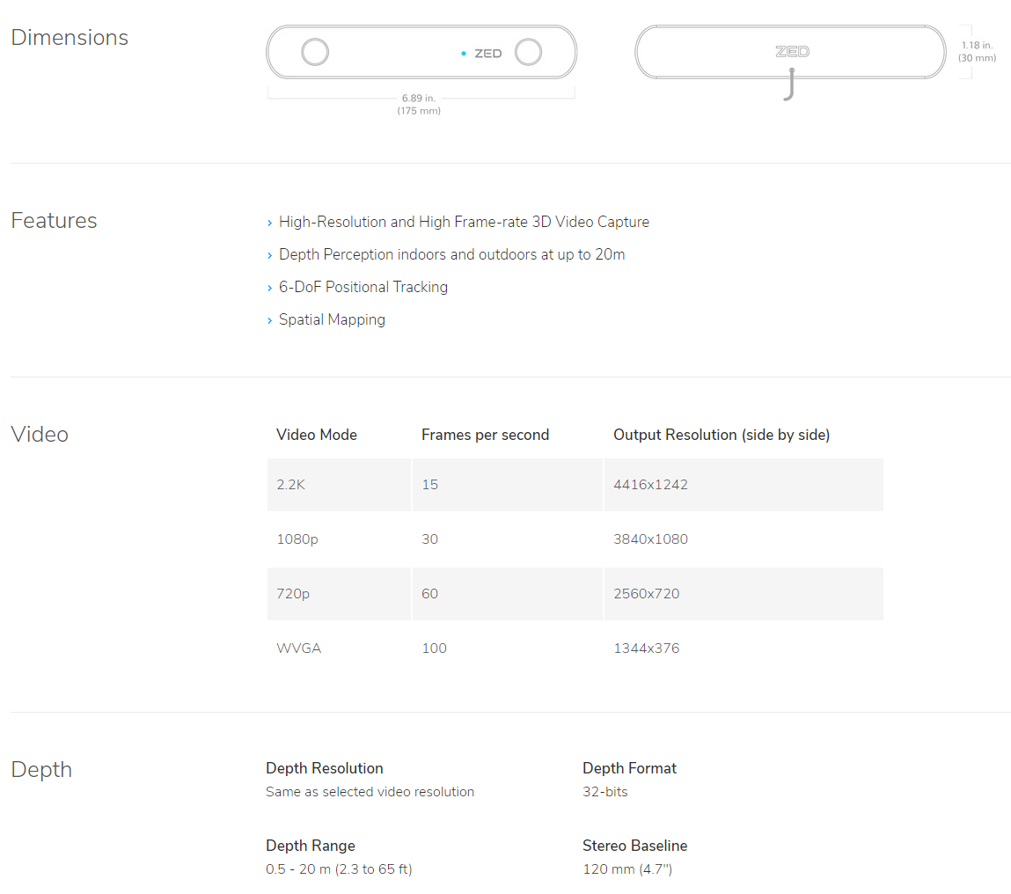
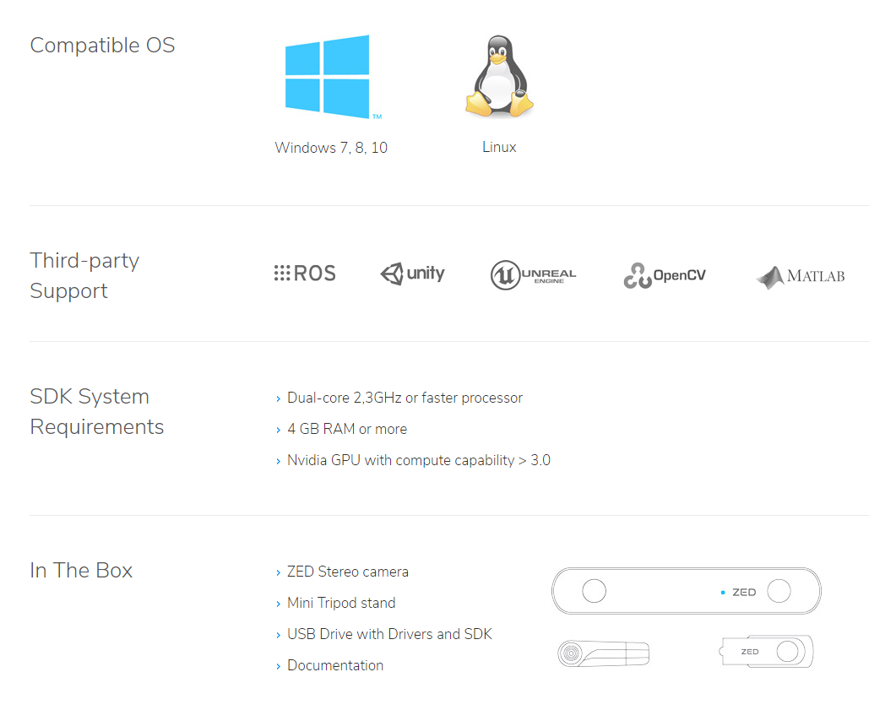

Slide 14
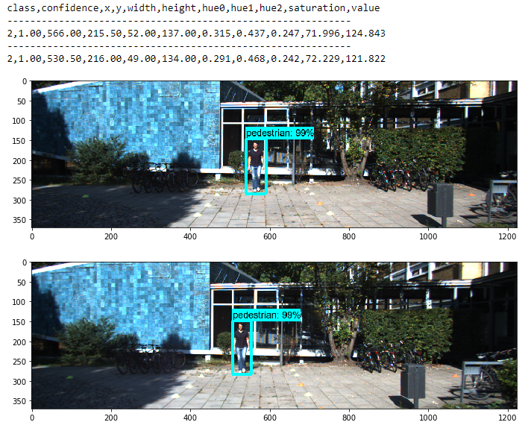
Mapping left and right image patterns
Pattern features to match
x,y = bounding box center location
saturation,value = mean values
3-bin hue histogram:
hue0
hue1
hue2

Slide 15
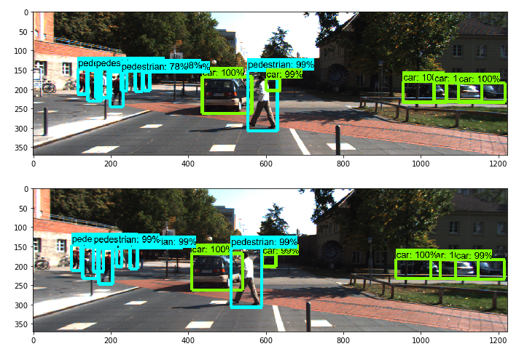
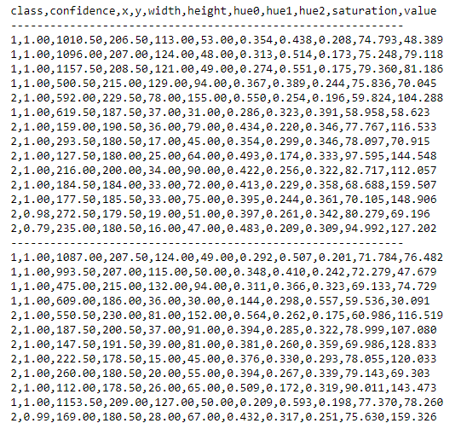
Pattern matching based on feature difference is required!

Slide 16
Probabilistic model, answering the question: What is the probability two patterns represent the same object?
Feature vector F:
confidence
x
y
width
heigth
hue0
hue1
hue2
saruration
value
Assumption:
P(i and j are same pattern) ~ N(F_{i} – F_{j} ∣ μ_{F} , V_{F})
Note: Class is not included as it is required to be the same

Slide 17
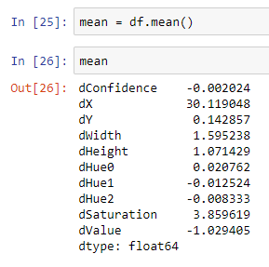
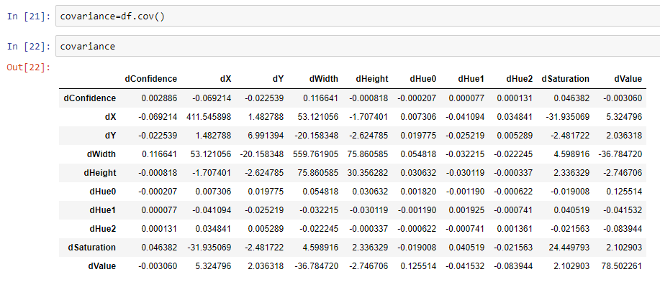
μ_{F} , V_{F} were estimated by matching 84 patterns in 28 KITTI stereo image pairs representing city, residential, campus and
person categories, including both cars and pedestrians.
Note: Mean disparity (dX) is appr. 30 pixels

Slide 18
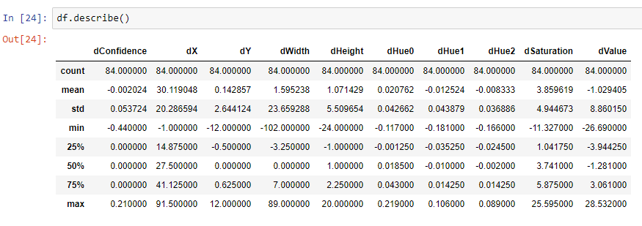

Slide 19
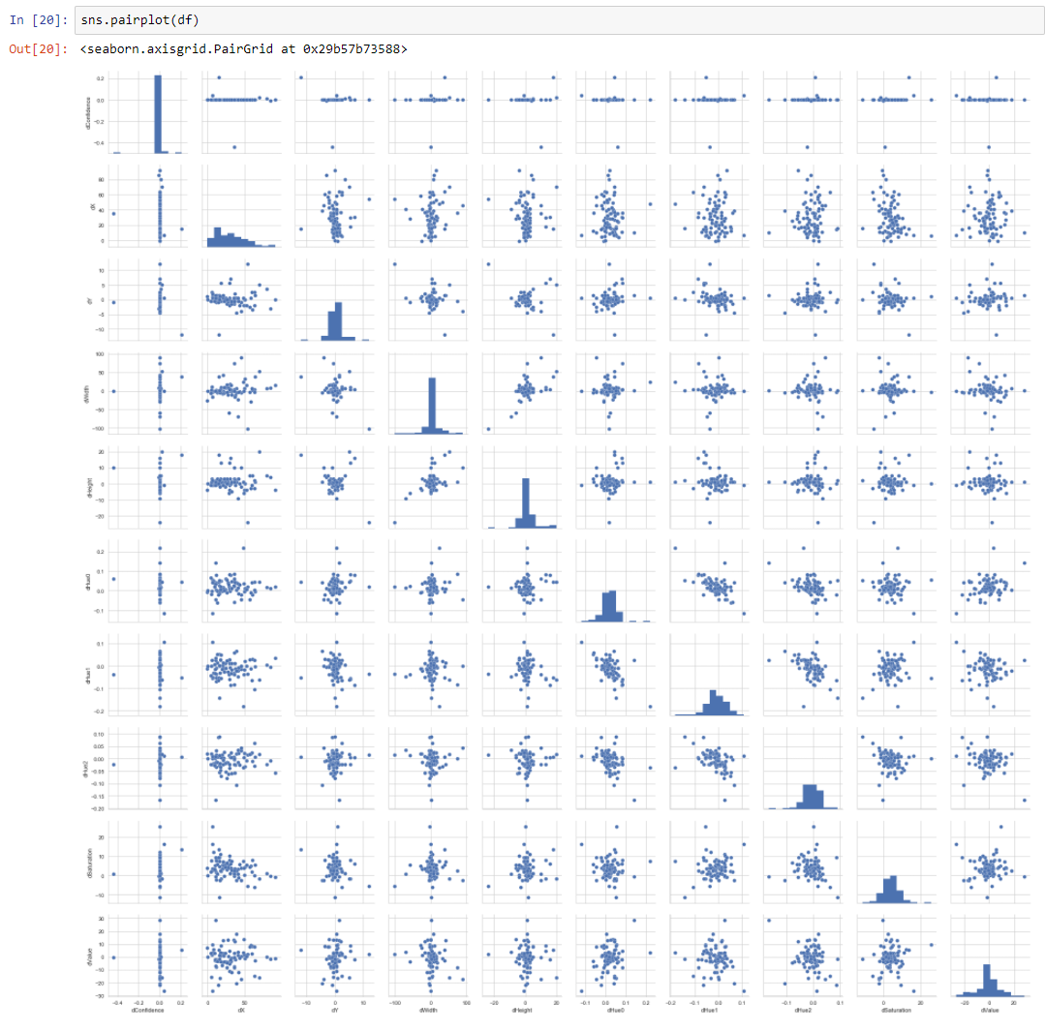

Slide 20
Pattern matching is done using Hungarian algorithm with the distance metrics:
d_{ij} = -log(P(i and j are same pattern)) = -log(N(F_{i} – F_{j} ∣ μ_{F} , V_{F}) )
If the probability that the patterns are same is near 1, the distance will be near zero. As the probability
decreases, the distance increases. The log is required to compare small numbers without numerical issues.

Slide 21
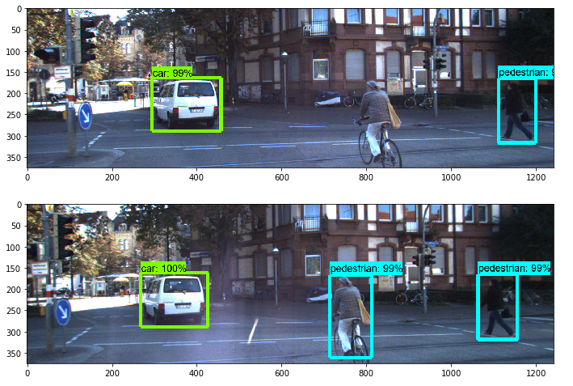
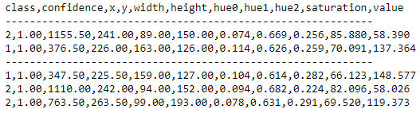
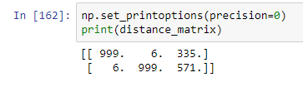
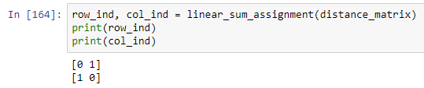
Simple example

Slide 22
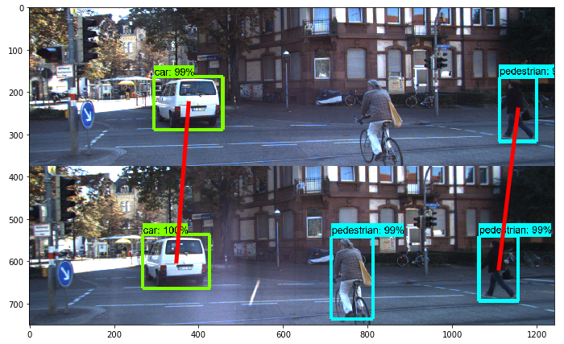

Slide 23
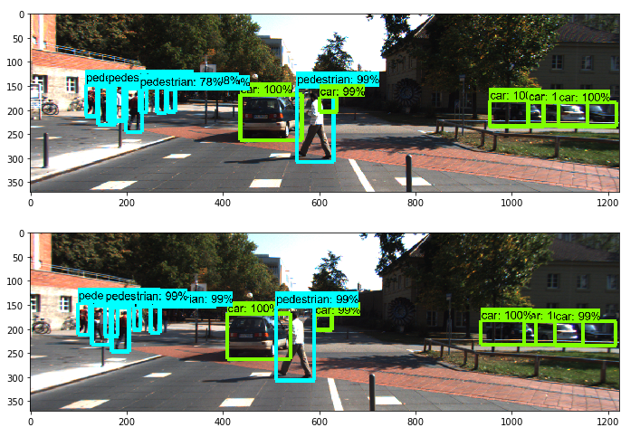
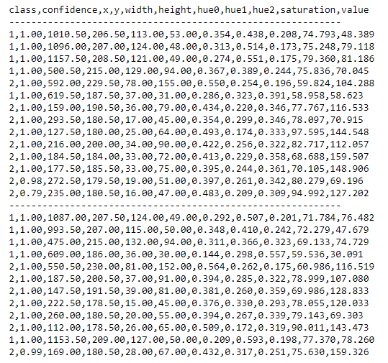
Complicated example

Slide 24
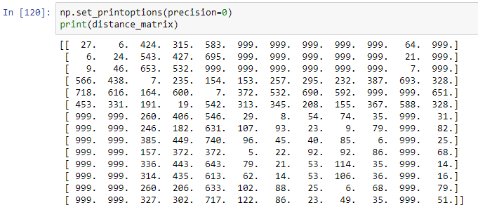
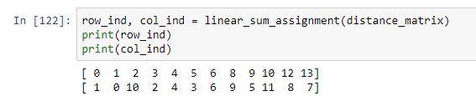

Slide 25
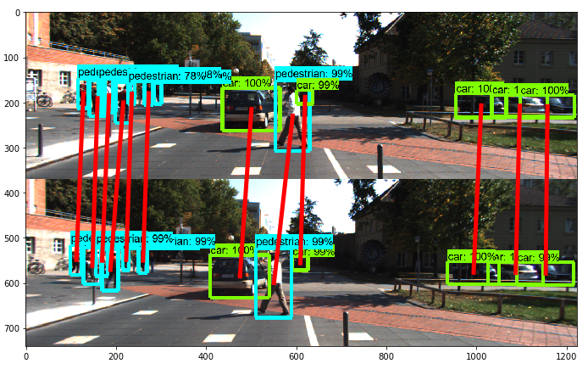

Slide 26
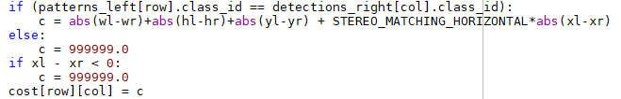
Too complicated!!! Curse of dimensionality makes probabilities (even with log) too small.
Simpler solution:
wl
Left camera pattern
xl,yl
wh
STEREO_MATCHING_HORIZONTAL = 0.4
Hungarian algorithm for matching.
wr
Right camera detection
xr,yl
wr
Note: Patterns are not generated for the right camera. Patterns life spans in two cameras lead to complications.

Slide 27
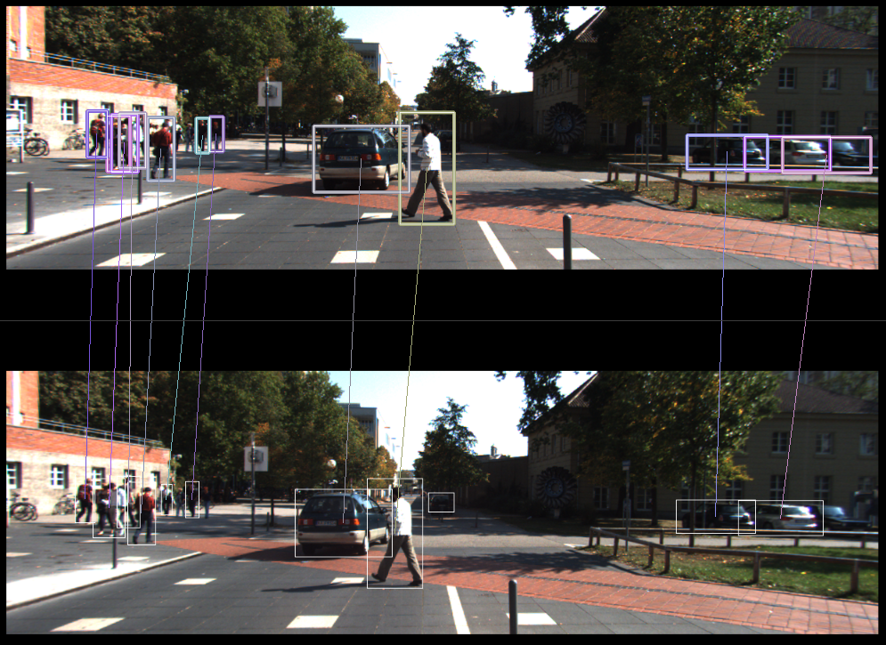

Not perfect, but good enough for the moment.
Research topic for 2019

Slide 28
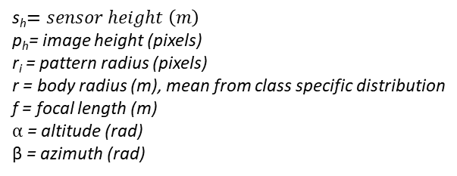
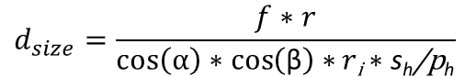
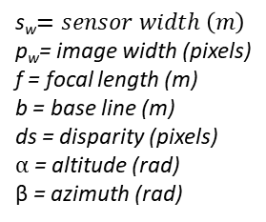
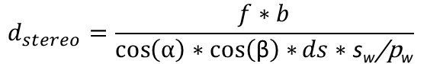
After implementing stereo vision, we have two distance estimates:
Distance based on stereo vision. Accurate in short distances (for Kitti, 20 meters)
Distance based on size. Can be used in long distances where stereo vision is inaccurate.
D
F
h
d =AF
C
E
G
h_{i}
α
A
B
f
$$d_{size}=\frac{f∗r}{\cos\left(α\right)∗\cos\left(\text{β}\right)∗r\text{i}∗\text{s}\text{h}\text{/}\text{p}\text{h}}$$
$$d_{stereo}=\frac{f∗b}{\cos\left(α\right)∗\cos\left(\text{β}\right)∗ds∗\text{s}\text{w}\text{/}\text{p}\text{w}}$$
s_{h}$=sensor height \left(m\right)$
p_{h}= image height (pixels)
r_{i} = pattern radius (pixels)
r = body radius (m), mean from class specific distribution
f = focal length (m)
$α$ = altitude (rad)
β = azimuth (rad)
s_{w}$=sensor width \left(m\right)$
p_{w}= image width (pixels)
f = focal length (m)
b = base line (m)
ds = disparity (pixels)
$α$ = altitude (rad)
β = azimuth (rad)

Slide 29
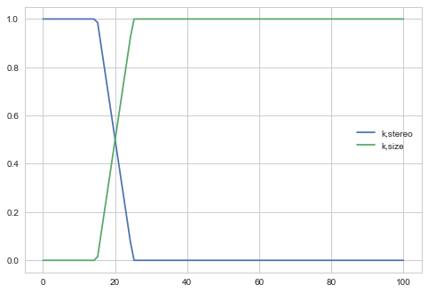
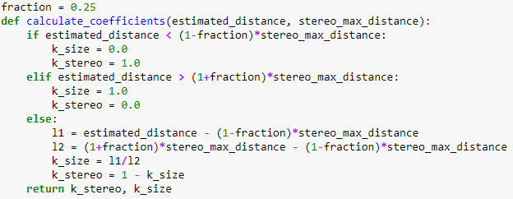
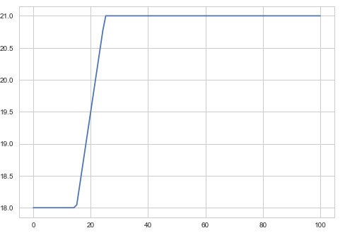
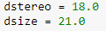
Combining distance estimates:
$d=k_{stereo}∗d_{stereo}+$ $k_{size}∗d_{size}$
stereo_max_distance = 20.0
Initialization:
$estimated_distance=0.5∗d_{stereo}+$ $0.5∗d_{size}$
Procedure is iterated until convergence or max_iter (or just used once?)

Slide 30
Estimating disparity using matched patterns
Left camera pattern:
x_min_left
x_max_left
Right camera pattern:
x_min_right
x_max_right
$Pattern disparity=$ 0.5 * (x_min_left+x_max_left)-0.5*(x_min_right+x_max_right)

Slide 31
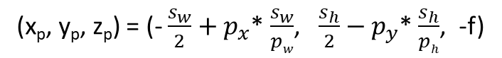
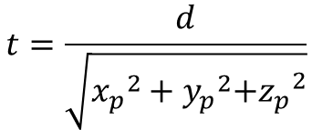
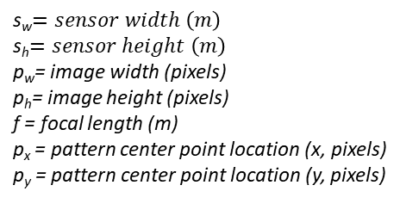
3D projection
x_{b},y_{b},z_{b} = body center point
y
x_{p},y_{p},z_{p} = pattern center point
x
z
(x_{b}, y_{b}, z_{b}) = t* (x_{p}, y_{p}, z_{p})
s_{w}$=sensor width \left(m\right)$
s_{h}$=sensor height \left(m\right)$
p_{w}= image width (pixels)
p_{h}= image height (pixels)
f = focal length (m)
p_{x} = pattern center point location (x, pixels)
p_{y} = pattern center point location (y, pixels)
Where:
(x_{p}, y_{p}, z_{p}) = (- $\frac{s_{w}}{2}+p_{x}$* $\frac{s_{w}}{pw}$, $\frac{s_{h}}{2}−p_{y}$* $\frac{s_{h}}{ph}$, -f)
$$t=\frac{d}{\sqrt{{x_{p}}^{2}+{y_{p}}^{2}{{+z}_{p}}^{2}}}$$
Note! Only left image used. Right image is used only for disparity calculation (in the context of distance estimation and 3D projection).

Slide 32
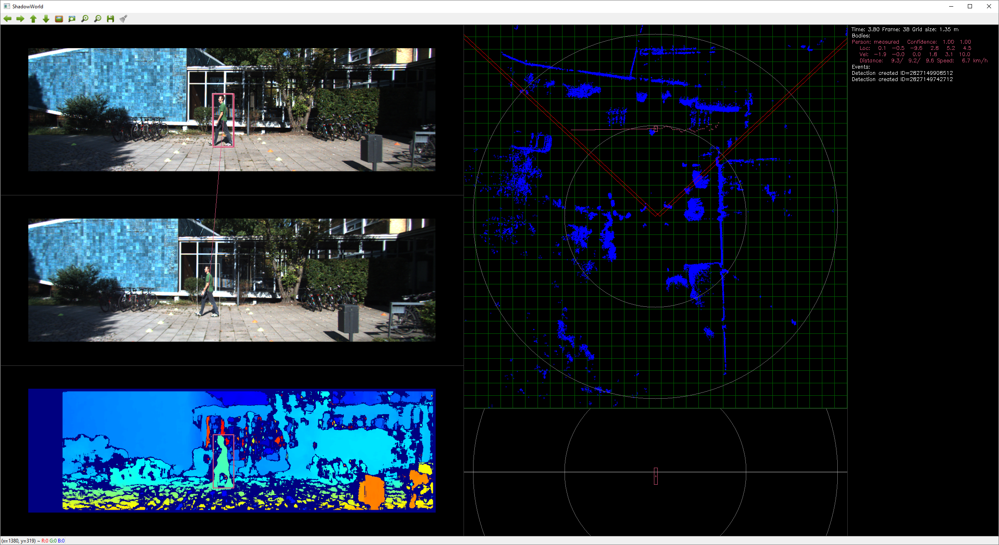

Slide 33
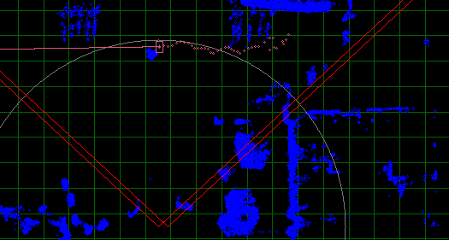
Localizations follows Velodyne cloud pretty well!

Slide 34
Current overall matching algorithm:
For left camera:
Create detections
Predict pattern locations
Match detections to patterns
For each unmatched detection
Create pattern
Create body
For right camera:
Create detections
Match right camera detections to left camera patterns
Predict body locations
Create location measurements based on size and stereo
Correct body locations
Note: Pattern and body removals are not described.

Slide 35
Research topic!
The joint estimation of pattern and body state would be a good area for further study. The current algorithm is by no means optimal.

Slide 36
Kalman Filter Parameter Adjustments
Two levels of filtering:
Pattern
Pattern movement estimation for missing detections
Body
Coordinate and velocity estimation

Slide 37
Detection
Pattern
Body
x_min
K1
x_min’ vx_min’
Distance estimation + 3D projection
x_max
K1
x_max’ vx_max’
K2
Left
y_min
K1
y_min’ vy_min’
x’
y’
y_max
K1
y_max’ vy_max’
x
z’
y
x_min
z
vx’
vy’
x_max
Right
vz’
y_min
y_max
Camera parameters

Slide 38
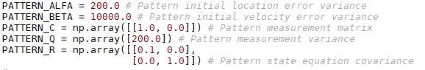
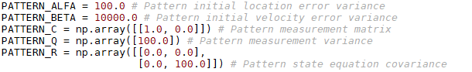
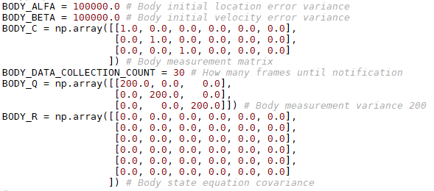
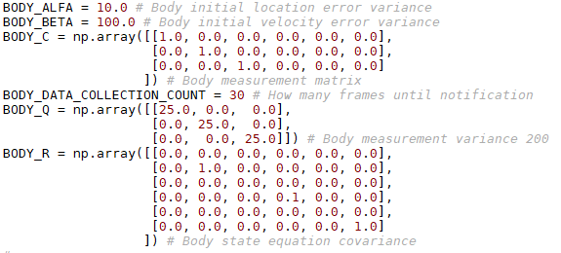
Before
After

Slide 39
PATTERN_ALFA
2*std = 20px, first detection bounding box accuracy
PATTERN_BETA
2*std = 200 px/s = 20 px / frame
PATTERN_Q
2*std = 20px, detection accuracy
PATTERN_R
Location, no teleporting
Velocity, 2*std = 20px/frame = 200 px/s
BODY_ALFA
2*std = 6 m, first location accuracy
BODY_BETA
2*std = 20 m/s
BODY_Q
2*std = 10m, measurement accuracy
BODY_R
Location, no teleporting
Velocity (x,z), 2*std = 2 m/s2
Velocity (y), 2*std = 0,6 m/s2

Slide 40
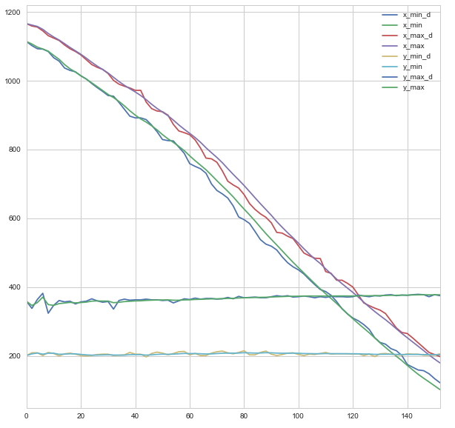

Pattern location / before
Pattern location / after

Slide 41


Pattern velocity / before
Pattern location / after

Slide 42


Body location / before
Body location / after

Slide 43


Body location / before
Body location / after

Slide 44
Research topic!
Note. The current filter architecture and parameters do their job, but certainly are
not optimal. Field for further study!

Slide 45

Body Volume and Orientation
Bounding sphere is not a good shape for volumes like car, human or train…
KITTI uses bounded 3D box

Slide 46


Assumption: Only yaw allowed
Each body is supposed to have “normal” movement direction, which defines length, height and width.
p₅
p₁
y
p₆
p₂
velocity = (v_{x},v_{y},v_{z})
α = yaw angle
p
height
p₇
p₃
α
x
p₈
p₄
width
length
$$α=atan2({−v}_{z},v_{x})$$
z
$$(p_{1,x},p_{1,y},p_{1,z})=(p_{x}+0.5∗length, { p}_{y}+0.5∗heigth,{ p}_{z}−0.5∗width)$$
…
$$(p_{8,x},p_{8,y},p_{8,z})=(p_{x}−0.5∗length, { p}_{y}−0.5∗heigth,{ p}_{z}+0.5∗width)$$

Slide 47






p’₁
Top view
b
v
p₅
n
p₁
$$α=atan2({−v}_{z},v_{x})$$
a
α
p₂
$\left[\begin{matrix}{p′}_{x,i} \\ {p′}_{y,i} \\ {p′}_{z,i}\end{matrix}\right]$= $\left[\begin{matrix}cos⁡(α) & 0 & sin⁡(α) \\ 0 & 1 & 0 \\ −sin⁡(α) & 0 & cos⁡(α)\end{matrix}\right]$* $\left[\begin{matrix}p_{x,i} \\ p_{y,i} \\ p_{z,i}\end{matrix}\right]$
p’₅
x
p
p₆
p’₂
p’₆
z
y
y’₁
$$y_{1}^{′}=height/2$$
Side view
$$y_{2}^{′}=−height/2$$
x’₂
x’₁
x
$$x_{1}^{′}=max⁡(x_{1},x_{2},x_{3},x_{4},x_{5},x_{6},x_{7},x_{8})$$
$$x_{2}^{′}=min⁡(x_{1},x_{2},x_{3},x_{4},x_{5},x_{6},x_{7},x_{8})$$
y’₂

Slide 48

Currently used for display. Collision detection still uses spheres. TBD

Slide 49
Grid Representation
Background:
Representing body movement forecast and probabilities in continuous world is presumably much more difficult than in discrete space. Grid is needed…

Slide 50

2D grid is used, with evenly spaced lines. GRID_COUNT parameter (=31)

Slide 51

Representing conditional path statistics and probabilities is easier with grid.

Slide 52

Note. KITTI dataset includes ”Person” category wich is well suited to do research.
Research topic!
Nearly 100 videos where one or more persons are walking using different paths across the same area.

Slide 53
y
World Coordinates, Yaw Estimation
x
z
Assumptions:
initially world coordinates coincide with left camera
y, roll and pitch are fixed
x and z are estimated from odometry (GPS)
yaw is estimated from optical flow, or given
Camera has three degrees of freedom:
x
z
yaw

Slide 54

Transformation from (left) camera coordinates into world coordinates:
(Szeliski)
c from odometry
R from optical flow

Slide 55
From camera coordinates into world coordinates:
body
x_{b}’,z_{b}’
$x_{b}=x_{c}+\cos\left(yaw\right)∗x_{b}^{′}+$ $\sin\left(yaw\right)∗z_{b}^{′}$
$z_{b}=z_{c}−\sin\left(yaw\right)∗x_{b}^{′}+$ $\cos\left(yaw\right)∗z_{b}^{′}$
x’
yaw
From world coordinates into camera coordinates:
camera
x_{c},z_{c}
$x_{b}^{′}=\cos\left(yaw\right)∗(x_{b}−x_{c})−$ $\sin\left(yaw\right)∗(z_{b}−z_{c})$
$z_{b}^{′}=\sin\left(yaw\right)∗{(x}_{b}−x_{c})+$ $\cos\left(yaw\right)∗(z_{b}−z_{c}$)
z’
x
world coordinates (initial camera location)
z

Slide 56

If more degrees of freedom are wanted:
(Szeliski)
So, quaternions, but later when needed…

Slide 57


Car going straight ahead. Optical flow to left is coloured blue,
and flow to right red. It is calculated using Farneback algorithm.

Slide 58


Car turning left. Optical flow is mainly to right and colored red/yellow.

Slide 59
From optical flow to yaw
Frame n+1
Frame n
dx

Slide 60





Approximation for small turns:
x1
x2
sensor plane
$$x_{1}=f∗tan⁡(α)$$
$$x_{2}=f∗tan⁡(β)$$
$$x_{2}−x_{1}=f∗\tan\left(α\right)−f∗tan⁡(β)$$
$$β=arctan⁡(\tan\left(α\right)−\frac{x_{1}−x_{2}}{f})$$
β
f
Substituting α=0 (reference):
α
$$γ=\left(amount of turning\right)=β−α=arctan⁡(\frac{x_{2}−x_{1}}{f})$$

Slide 61


s_{w}$=sensor width \left(m\right)$
p_{w}= image width (pixels)
f = focal length (m)
dx_{p} = horizontal optical flow in pxels
$$γ=\left(amount of turning\right)=β−α=arctan⁡(\frac{x_{2}−x_{1}}{f})=arctan⁡(\frac{{dx}_{p}∗sw}{f∗pw})$$
Cumulative yaw is maintained for the reference (left) camera:
$${yaw}_{n}=\sum_{i=1}^{n}{γ_{i}}$$
Note: Approximation and optical flow errors are cumulative over time. However, the major effect of error is that the initial reference coordinate system is turning in space around y-axis. As this is completely arbitrary, it doesn’t matter much. If we would like to map environment, it would matter more.

Slide 62

Distribution of horizontal flow values
Areas without high fequency details
Usable area
Objects moving in opposite direction?
Ad hoc algorithm to determine ’average’ background optical flow:
Determine main direction (+/-) by calculating mean of flows
Drop all flows in the opposite direction
Calculate mean value of flows in right direction
Drop all flows whose absolute value is below mean value
Determine the final value by calculating mean value of remaining flows

Slide 63

Naive ad hoc algorithm is not very good, but a starting point…

Slide 64

Note 1. Lucas-Kanade algorithm is another possibility. It concentrades on areas with texture and high frequency details. Anyway, areas corresponding to patterns should be eliminated.
Note 2. KITTI dataset includes 6 DOF data for moving camera. Lots of data to do research!!!
Research topic!

Slide 65

Common Objects in Context
COCO Dataset
Why?
171 everyday common categories
Large amount of images
Good API
Emerging support for implementations
Captions

Slide 66


COCO things (=bodies)

Slide 67


COCO stuff

Slide 68

ShadowWorld 4.0 user interface for COCO (with faster rcnn/resnet101 object detection network):

Slide 69

Semantic Segmentation
Why?
The goal is to give rich view description. For that, we need
the bodies (things) and context (stuff).

Slide 70
Unfortenately, there is no TensorFlow implementation for COCO stuff detection. However, there are Caffe
implementations. For those implementations, necessary files for converting them into OpenCV DNN
could not be found.
Options to continue:
Wait until TensorFlow implementation is available.
Learn Caffe and export an implementation into TensorFlow (or construct a bridge from Caffe to TensorFlow).
Take existing TensorFlow implementation (for example DeepLab/Pascal VOC 2012) and use transfer learning to adapt into COCO.
Teach a TensorFlow network from scratch.
I chose to wait until July 2018. If there is no TensorFlow implementation at that time, option 2 is followed. If that fails, option 3 is taken. Option 4 would be very tempting, with a lot to learn. However, there are so many moving parts and hyperparameter adjustments in the process, that this time option 4 should be avoided. If it were followed, it would be a great research topic. It would also require using cloud services, which are not free.
Data is available.

Slide 71


Until having a semantic segmentation implementation, the COCO ground
truth will be used to develop natural
language models.
To summarize:
Things are created by object detection, stuff
using semantic segmentation.

Slide 72
Speech Recognition
SpeechRecognition 3.8.1 Python package
+
PocketSphinx
Google API Client Library for Python +
Google Cloud Speech API much more better, but not free.
Will be used in the prototype. Requires network connection.

Slide 73

Use Cases

Slide 74


Slide 75

Attribute extraction
Requires specific network
OCR
Impossible?
Research topic!

Slide 76

Note: Because VizWiz is based on q/a data on
specific mobile app, some questions are
absent, probably because people know it is
unable to give the answer. Most notably,
questions beginning ”where”. This is where
image based situation awereness shines!
But it also means that we cannot use pure
VizWiz as learning and evaluation dataset.
Another set of questions having only small
number of representatives is ”How many…?”
The goal will be to cover large amount
of this this circle + some extra questions.

Slide 77

ShadowWorld integration (easy example, more behind the link on Youtube video…)

Slide 78
Dataset Roles
KITTI
3D object localization
State estimation
Forecasting
COCO
Object and stuff classes
Network implementations
VIZWIZ
Use cases

Slide 79

Using masks instead of (or with) bounding boxes:
New Ideas
Mask can be applied to conventional stereo disparity map to get
many distance measurements. Object attributes more accurate.

Slide 80

TensorFlow Object Detection Model Zoo
Current network
Mask networks

Slide 81



Particle cloud representation for both things (bodies) and stuff
Volumes
Helps probabilistic reasoning
Grid (2D or 3D) world representation
Enables set of methods and tools developed for grid representation

Slide 82
Entity definition changes:
Body -> Thing, Stuff
Pattern -> Track

Slide 83

Learning costs for pattern and detection matching:

Slide 84
Solving assignment problem in multi-target stereo tracking
Track and detection representation
Cost
Algorithm
Life spans
3D stuff structure from 2D stereo video
Stuff representation
Stuff detection
Distance
Location
3D thing state estimation based on 2D stereo video
Thing representation
Thing detection
Distance
Location
Velocity
Object search and moving guidance
World representation
Egomotion
Future projection
Collision detection
Exploration and exploitation
Research Topics

Slide 85
Next Steps

Slide 86

The Big Picture
Thing Detection
Detections
Tracking
Things
State Estimation
Stereo Disparity Estimation
Depth
Thing Locations
And Velocities
Structure From
Depth
Stuff
Location
Stuff Segmentation
Stuff
World Generation
Optical Flow
ROI Flow
Egomotion
Estimation
Observer
Location
Actions
Planning
Functionality
Contribution
Data

Slide 87
World representation
Top view
thing
stuff
unknown
observer
goal
Assumptions:
Stuff does not move
Things move with constant velocity
State estimation provides thing location and velocity + uncertainties
State consists of
Stuff locations
Thing locations and velocities
Observer location
Confidences (known/unkown)
Things move independently
State is fully observable
Observer motion can be estimated from relative stuff locations

Slide 88
Voxel world representation
Examples:
Outdoor environment: area of interest 100m*100m*10m, 1m3 voxel => 100 000 voxels
Indoor environment: area of interest 10m*10m*3 m, 10cm*10cm*10cm voxel => 300 000 voxels
?
Things, stuff, observer and confidence are represented as occupancy maps.

Slide 89
General prodecure:
For each functionality:
Paper and literature references are collected
Document (paper) is written
Goal
Input data
Output data
Method survey
Tests with KITTI
For each data:
Representation is described
Prototype is constructed
COCO things and stuff
Selected methods are integrated and tested
Summary document is written:
Overall desctiption
Selected methods listed and reason for selection given
Test results

Slide 90
Discussion

Slide 91
Thank you!
lampola@student.tut.fi
https://github.com/SakariLampola/Thesis

